Slide 1

Team Introduction
Our project team consists of 4 dedicated members, each bringing unique skills and expertise to create an exceptional expense tracker app.
Deepanshu Sharma (2110992199)
Harsh Bhonsle (2110992207)
Vansh Singla (2110992137)
Om Bansal (2110992221)

Slide 2

Welcome to Books
Welcome to the Books website, your one-stop destination to buy and sell books of all genres. Whether you're a book lover or looking to declutter your shelves, Books is the perfect platform for you. Explore our vast collection and join our community of book enthusiasts today.

Slide 3
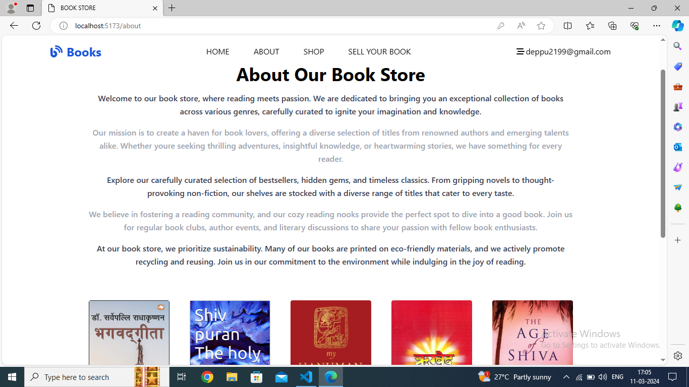

Slide 4
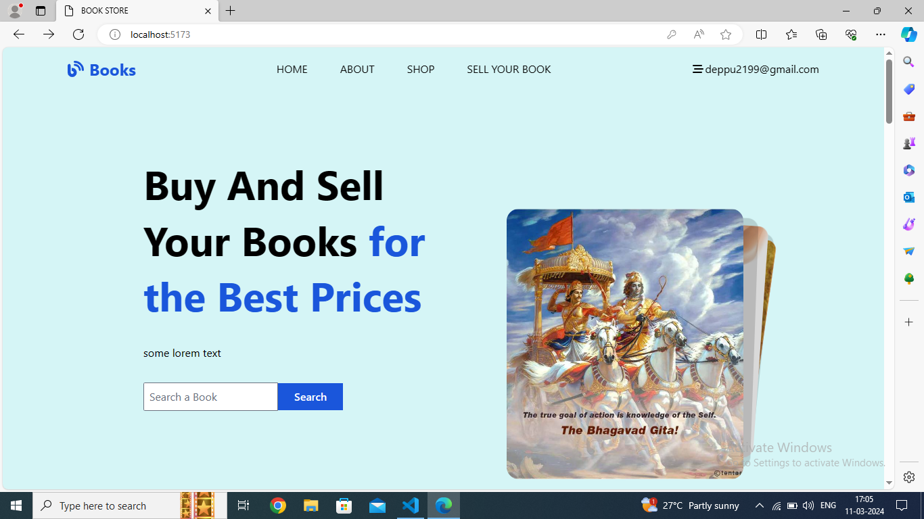

Slide 5

Problem Statement: Lack of Platform for Buying and Selling Books
Limited Availability
Unmet Demand
Many book enthusiasts struggle to find a convenient platform for buying and selling books.
There is a significant unaddressed need for a dedicated marketplace for book transactions.
Difficult Transactions
Current options often lead to complicated or inefficient book buying and selling experiences.

Slide 6
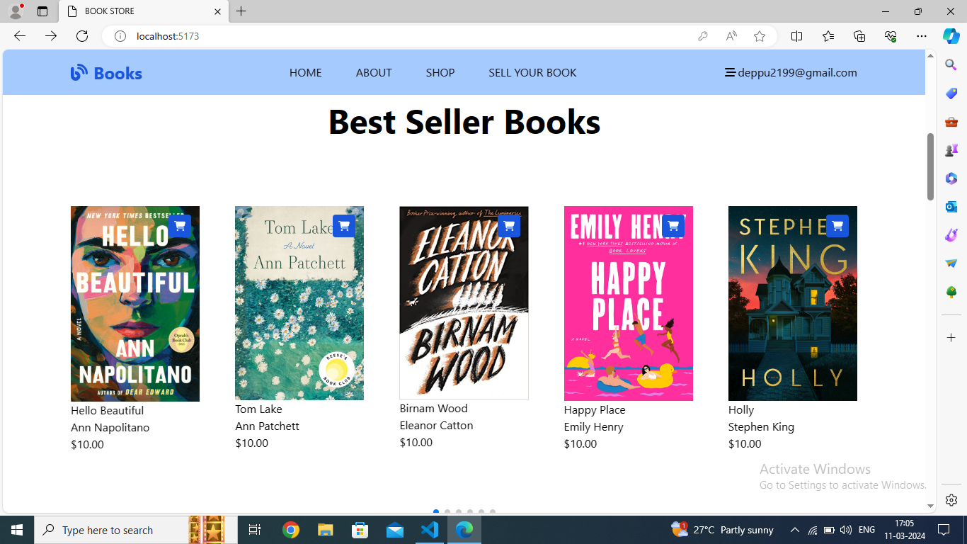

Slide 7

Features of the Books website
Wide variety of books: Explore a diverse collection of fiction, non-fiction, textbooks, and more
Book ratings and reviews: Gain insights from fellow readers and contribute your own feedback

Slide 8
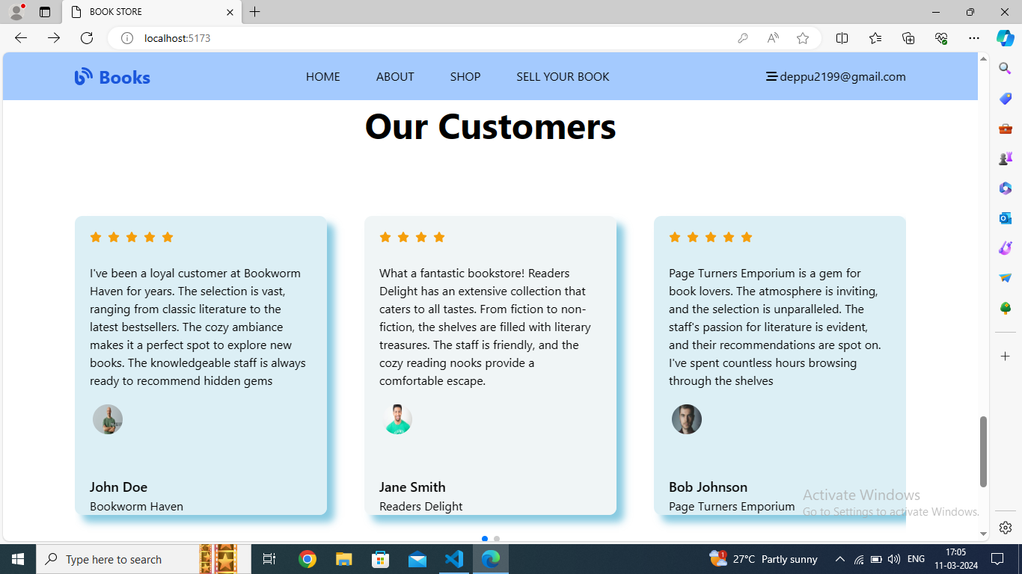

Slide 9
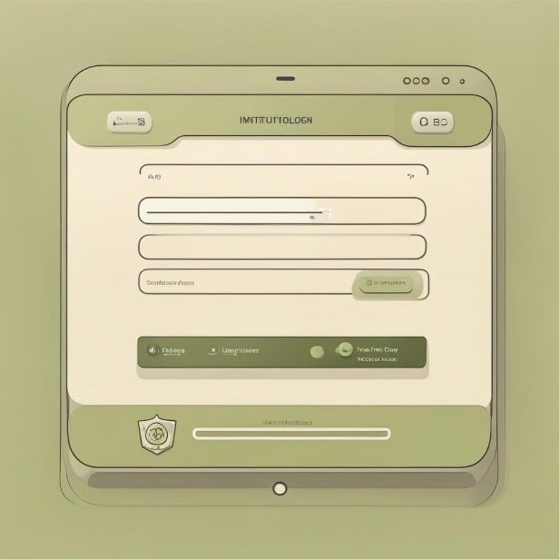
User Registration and Login Process
Users can easily register on the Books website by providing their basic information such as name, email, and password. Alternatively, they can also sign up using their Google or Facebook accounts for a seamless experience.
After registration, users can securely log in using their credentials to access their account, manage their book listings, and engage in buying or selling activities.

Slide 10
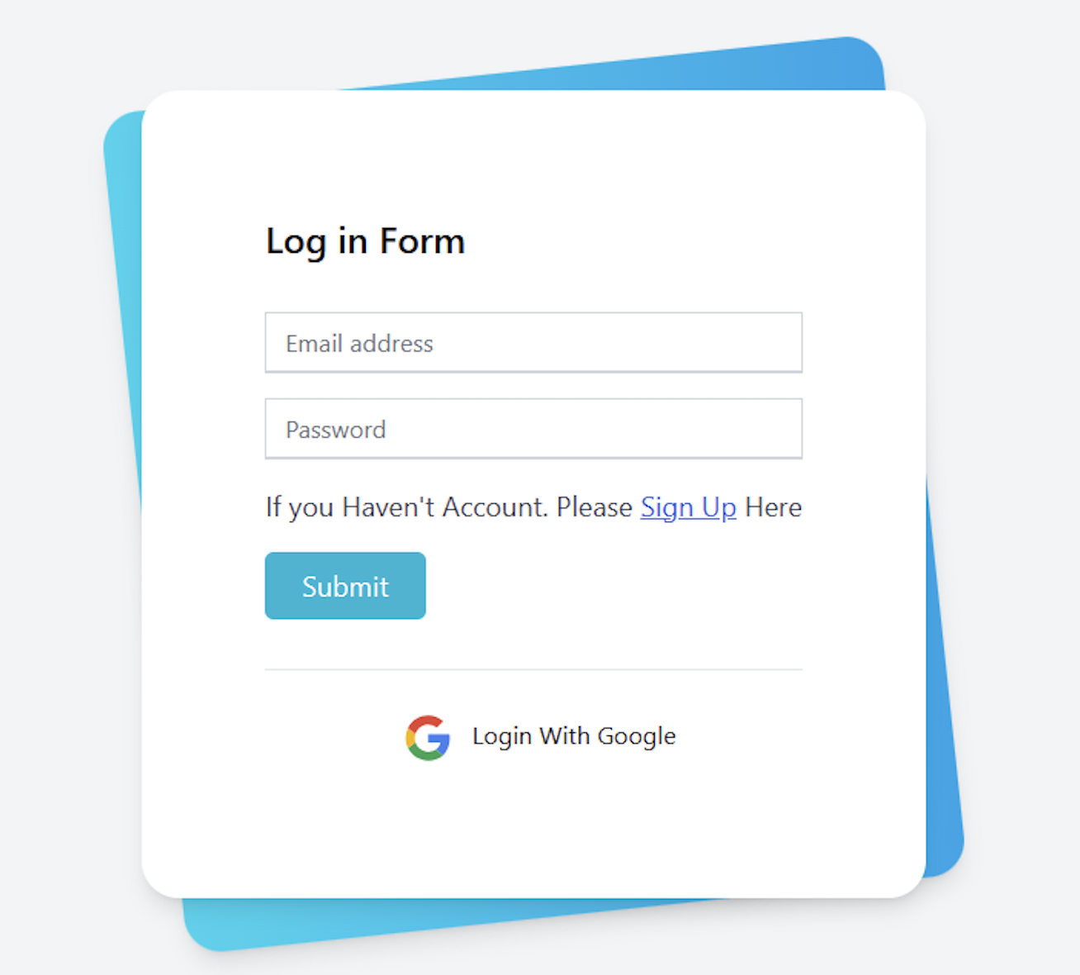
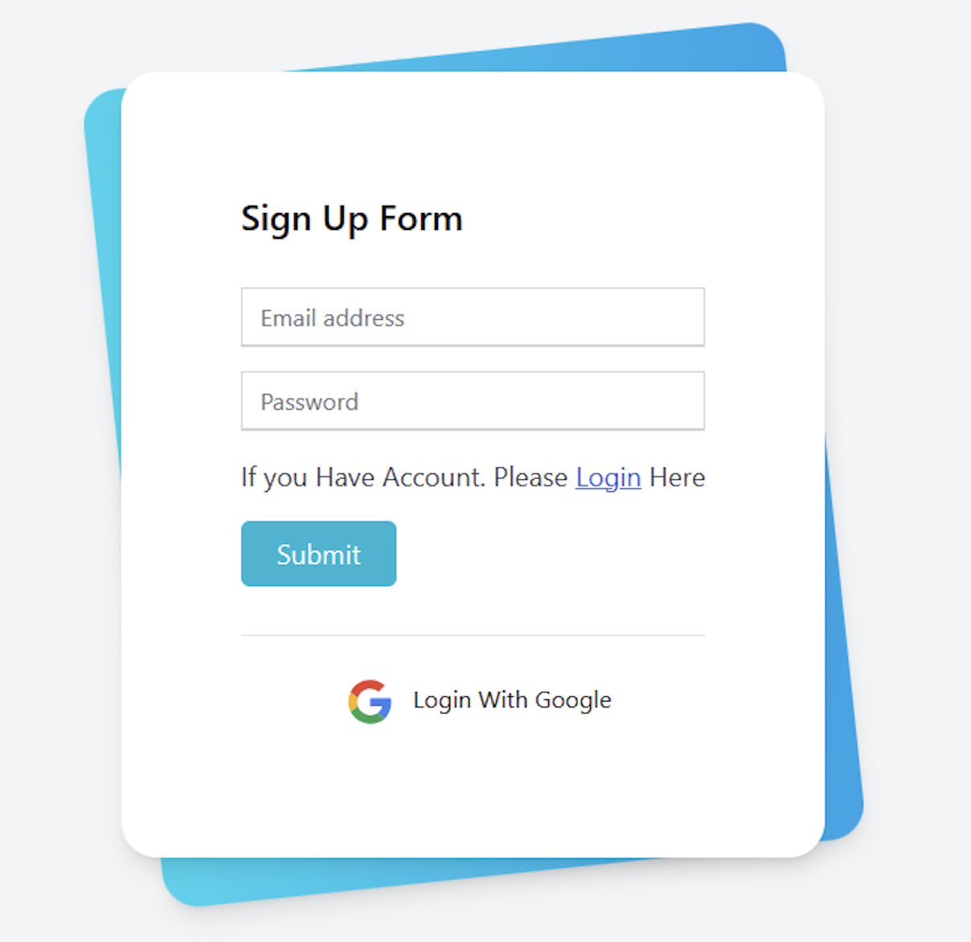

Slide 11
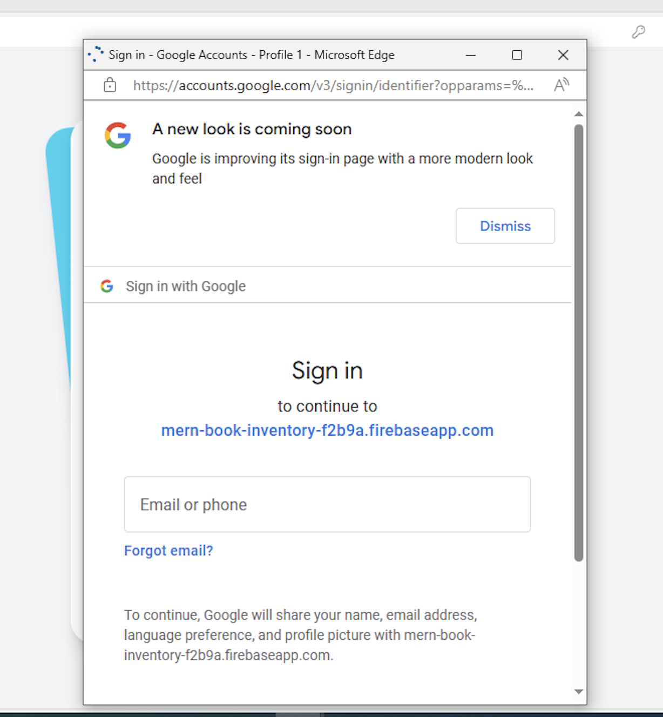
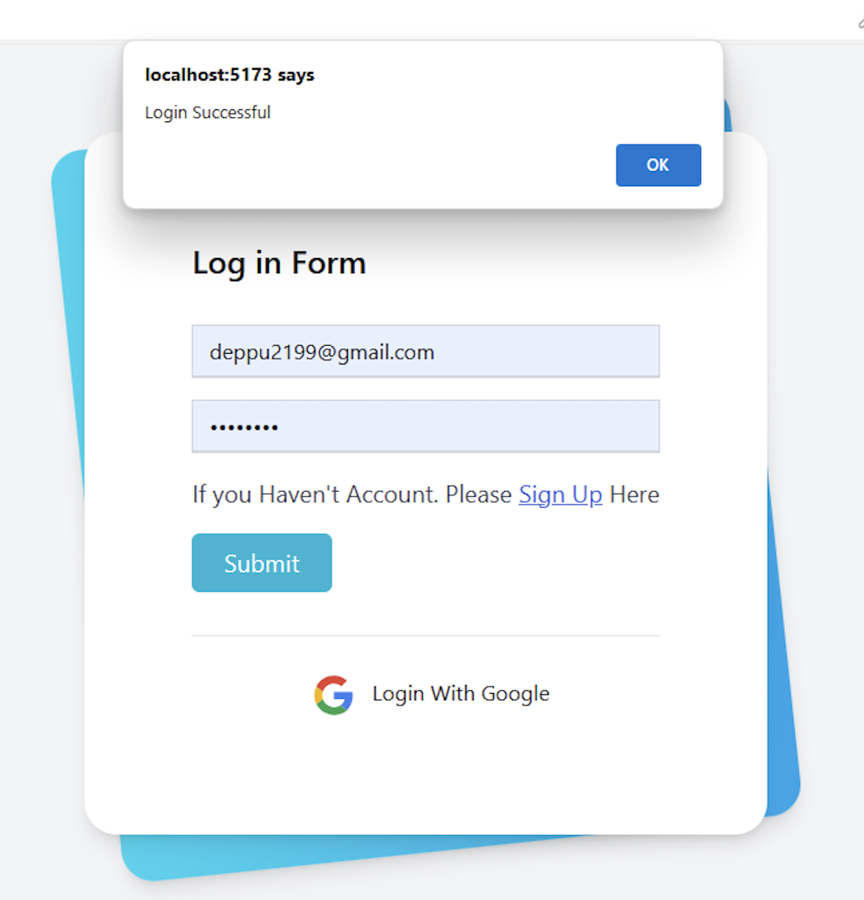

Slide 12
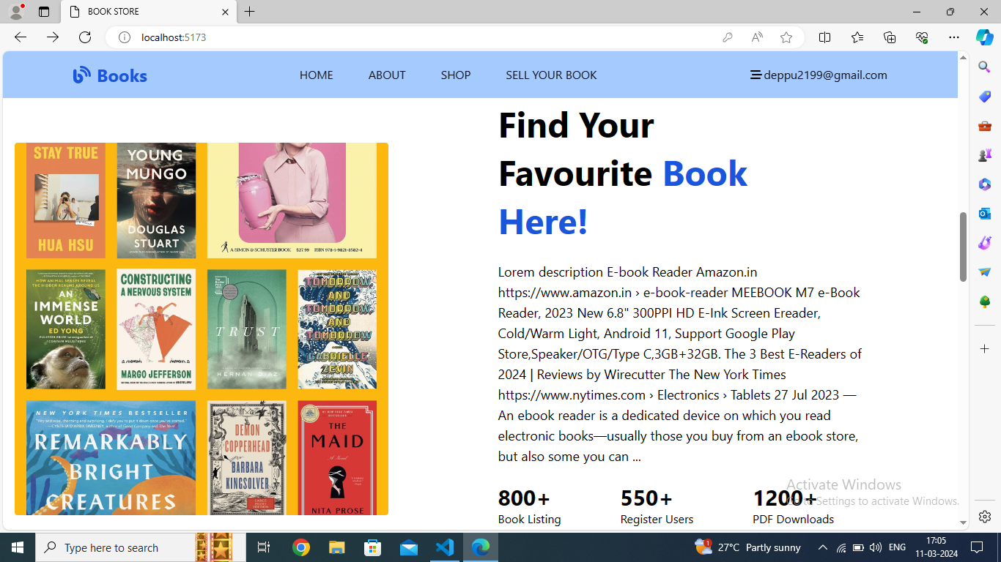
Search and Browse Functionality for Books
Simple Search
Users can easily search for books by title, author, or genre.
The search bar is prominently displayed on the homepage.

Slide 13

Buying process on the Books website
1
Book Search
Users can search for books by title, author, or genre on the website.
2
Book Details & Selection
After finding the desired book, users can view its details and select it for purchase.
3
Checkout & Payment
Users proceed to checkout, review their order, and make a secure payment for the book.

Slide 14
Selling process on the Books website
List your book
1
Provide details and set a price
Upload photos
2
Display your book's condition
Set shipping options
3
Choose your preferred shipping method
Wait for buyer
4
Review offers and communicate with buyers

Slide 15
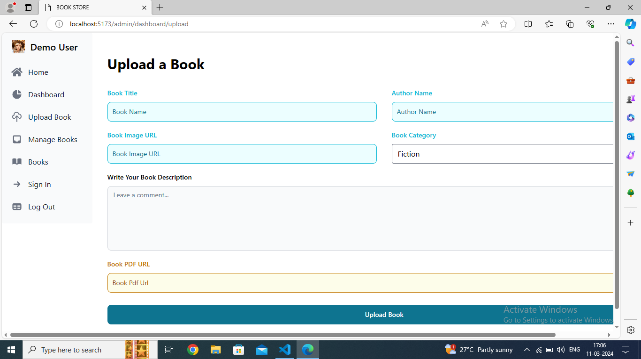

Slide 16
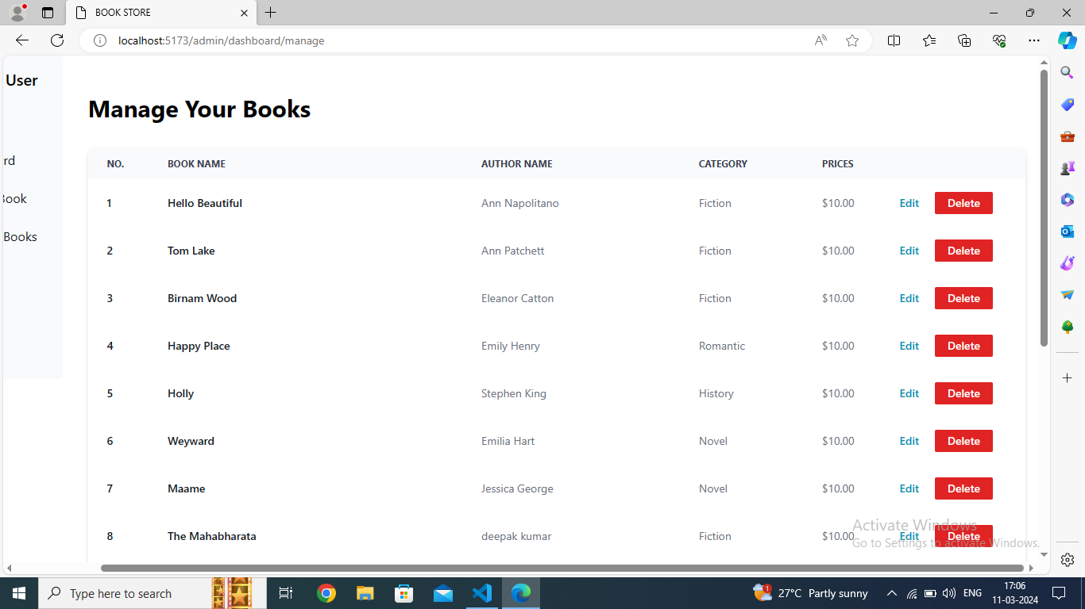

Slide 17



Personalised Dashboard
User Profile
Bookmarks
Communication
Save your favourite books and keep track of your reading list.
Connect with other users, authors, and support for discussions and assistance.
Customise your profile information and preferences for a personalised experience.

Slide 18
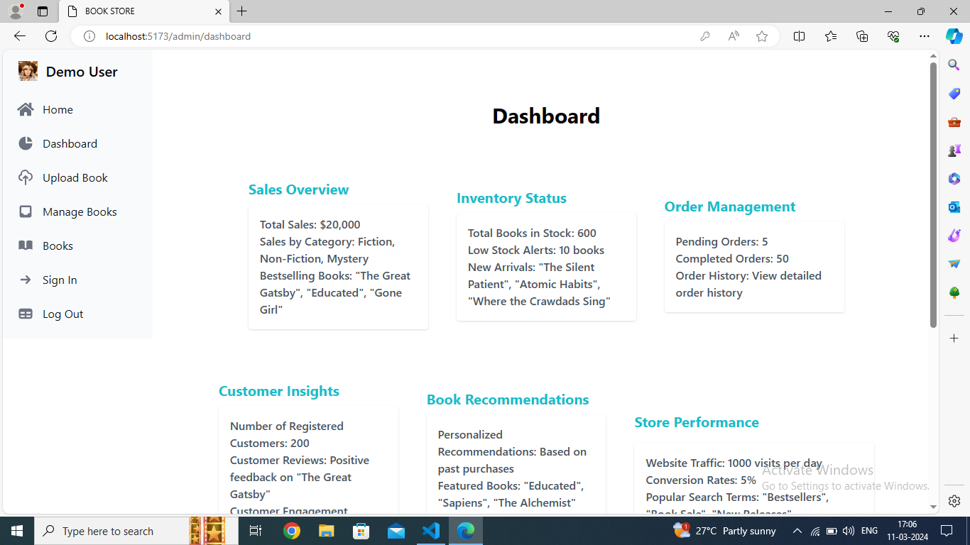

Slide 19

Customer Support and Feedback
At Books, we prioritise customer satisfaction. Our dedicated support team is available 24/7 to assist with any inquiries or issues. Whether it's a question about a book listing or feedback on your experience, we're here to help.
Additionally, we value your feedback to continually improve our platform. Feel free to share your thoughts and suggestions to enhance your buying and selling experience.

Slide 20
Conclusion and Call to Action
Join the Book Community
Start Selling Your Books
Connect with fellow book lovers and discover a wide range of books for sale.
Turn your shelves into cash and contribute to the book economy.
Explore New Reads
Contribute to Knowledge Sharing
Find your next favourite book and support the book community.
Share your reviews and recommendations to help other readers.

Slide 21
